Slide 1
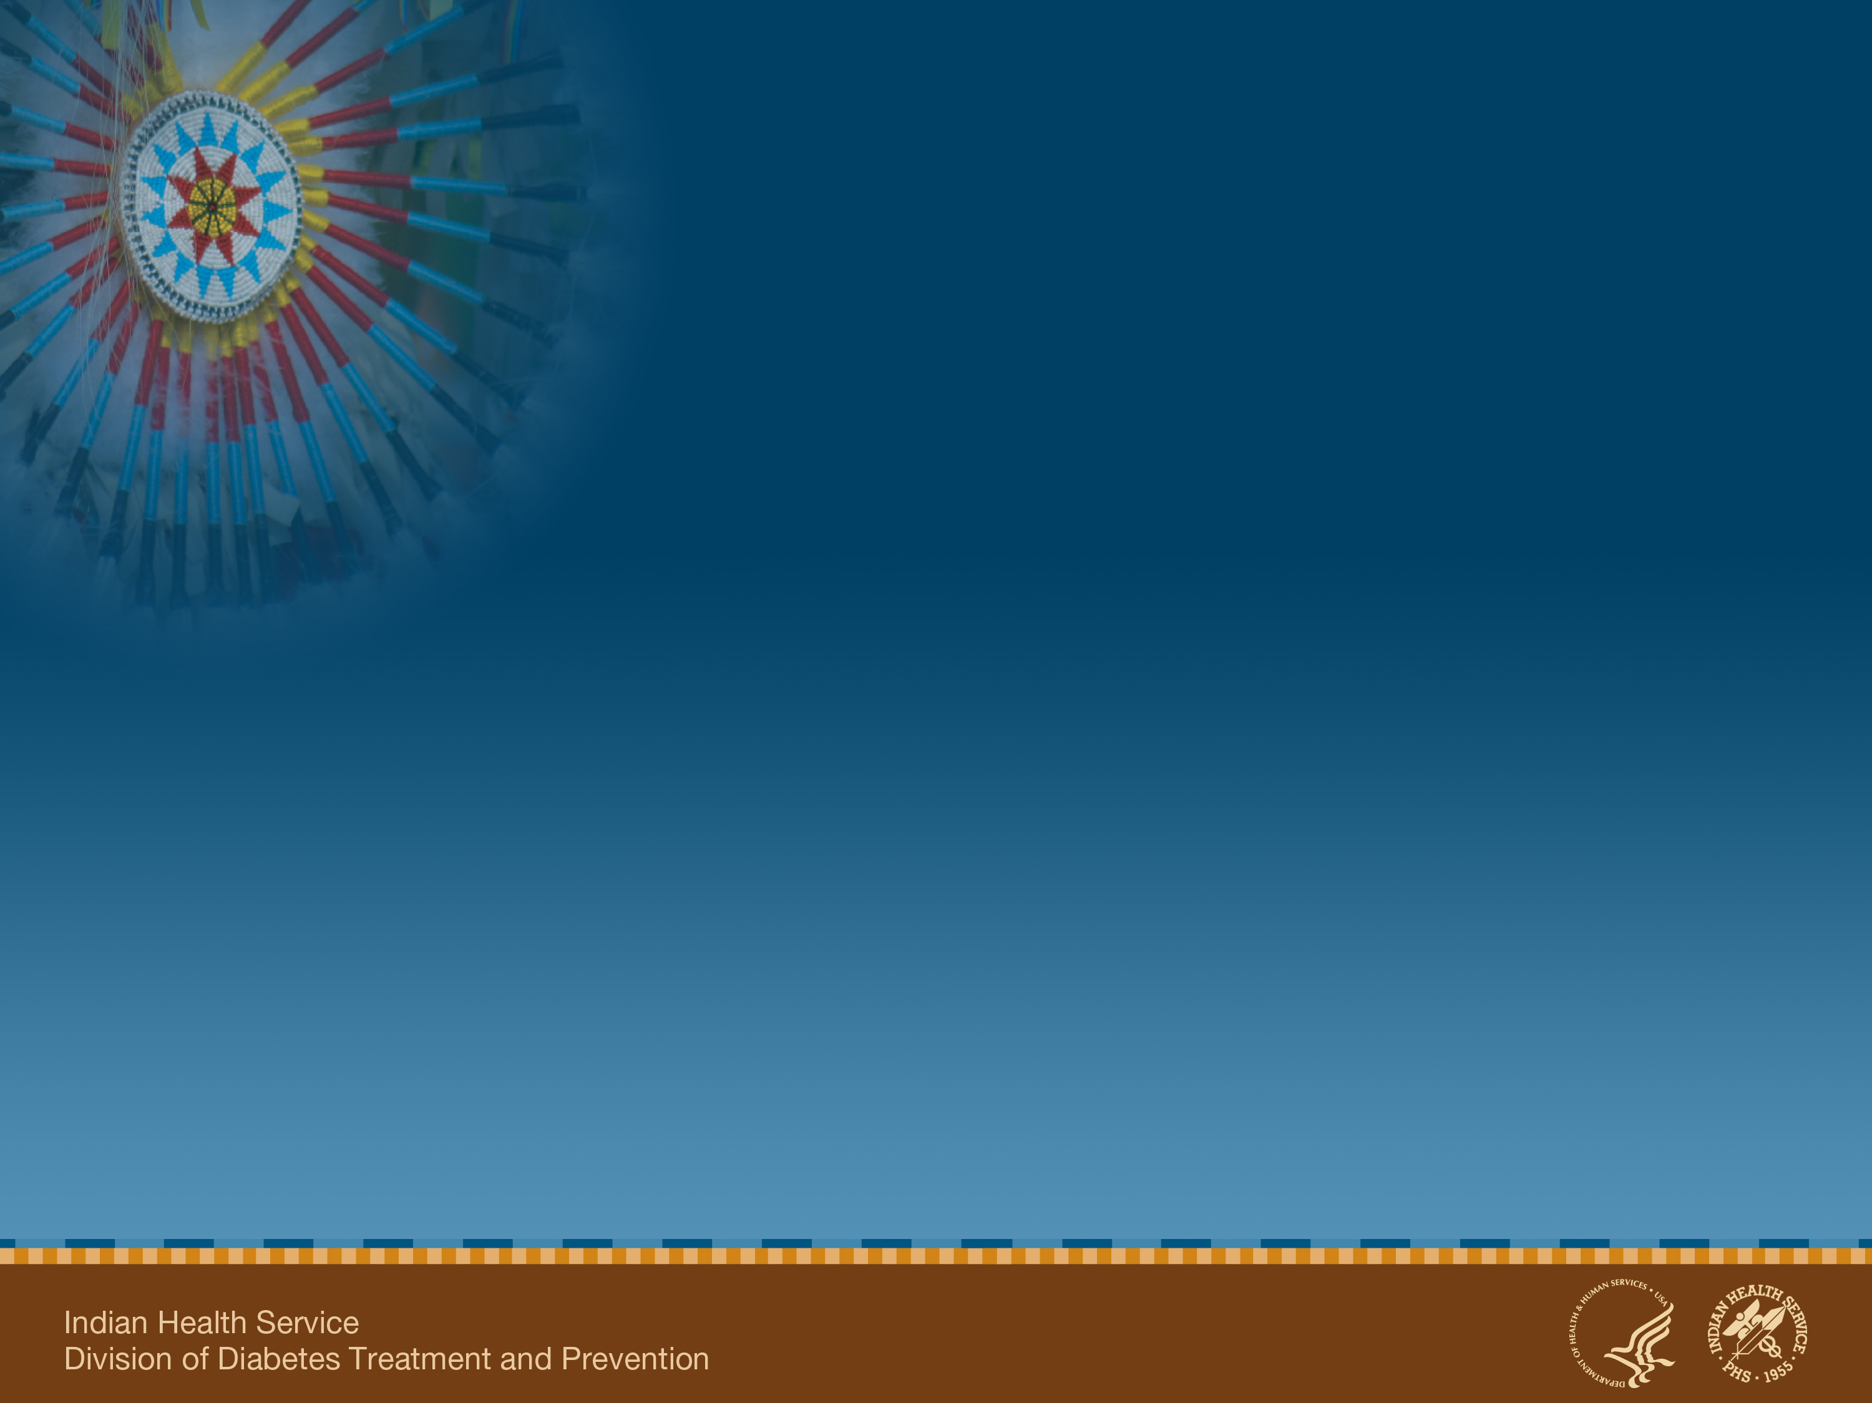
Indian Health Service Division of Diabetes Treatment and Prevention (DDTP)
Special Diabetes Program for Indians
Notes:
Hello. I am ______________.
The IHS Division of Diabetes plays a central role in managing and supporting the Special Diabetes Program for Indians.
Using current scientific research and evidence-based best practices, SDPI grant programs have made tremendous improvements in diabetes treatment and prevention in both clinical settings and community-based programs.

Slide 2

Special Diabetes Program for Indians (SDPI)
The SDPI was established by Congress in 1997
Today, provides $150 million/year for the prevention and treatment of diabetes through FY 2013
The SDPI currently provides grants for 404 programs in 35 states:
338 Community-Directed Programs
66 Initiatives (formerly “Demonstration Projects”)
Notes:
With the Balanced Budget Act of 1997, Congress established the Special Diabetes Program for Indians – SDPI – in response to the diabetes epidemic among American Indian and Alaska Native people.
Today, the SDPI is a $150 million per year program that provides grants for 404 IHS, Tribal, and Urban Indian health programs across the Indian health systems. At Congress’ direction, SDPI has two components: the Community-Directed Programs, and the Demonstration Projects which were transitioned into SDPI Initiatives in October 2010.

Slide 3
Special Diabetes Program for Indians 1997 - 2013
$30 M $100 M $150 M
1997-2000 2001-2003 2004-2013
Notes:
The program has grown from $30 million in 1997 to 2000 to $100 million in the years 2001-2003, to the current funding of $150 million per year through FY 2013.
SDPI has provided the funding, tools, training, support, and clinical data to help the Indian health system make tremendous changes in the diabetes landscape in American Indian and Alaska Native communities.

Slide 4
Special Diabetes Program for Indians (SDPI) Legislative History (1 of 3)
Balanced Budget Act of 1997 (Public Law 105-33) | $30 million per year (1998–2002) | Establish the original Special Diabetes Program for Indians grant program for the “prevention and treatment of diabetes” in American Indians and Alaska Natives. Conduct a comprehensive evaluation of the Program.
Consolidated Appropriations Act of 2001 (Public Law 106-554) | Added $70 million per year (2001–2002) $100 million for 2003 | Continue diabetes treatment and prevention activities in Tribal communities. Implement a best practices approach to diabetes treatment and prevention. Build upon what the grant programs have learned.
Notes:
(Optional – the 3 slides provide detailed legislative history)
The Special Diabetes Program for Indians resulted from a bipartisan Congressional plan to provide funds for the treatment and prevention of diabetes in American Indians and Alaska Natives. This initiative came in the wake of increasing public concern about the human and economic costs of diabetes in the United States and its growing prevalence in vulnerable populations, particularly American Indians and Alaska Natives.
Congress established the initial Special Diabetes Program for Indians through the Balanced Budget Act of 1997 for the “prevention and treatment of diabetes” in American Indians and Alaska Natives.
In 1998, IHS awarded grants across Indian health with a budget of $30 million per year.
In 2001, Congress added $70 million per year through the Consolidated Appropriations Act; increasing yearly grant funding to $100 million through 2003 with the addition of implementing a best practices approach.

Slide 5
SDPI Legislative History (2 of 3)
House Resolution 5738 (Public Law 107-360) | $150 million per year (2004-2008) | Continue ongoing diabetes treatment and prevention activities in Tribal communities as Community-Directed Diabetes Programs. Strengthen the IHS diabetes data infrastructure. Develop and implement competitive Demonstration Projects for: (1) primary prevention of diabetes in American Indians and Alaska Natives at risk for developing diabetes; and (2) cardiovascular disease risk reduction in American Indians and Alaska Natives with diabetes.
Public Health Service Act - 23 (42(U.S.C. 254c-3(c)(2)(C)) | $150 million (2009) | Continue activities as in 2004-2008
Notes:
House Resolution 5738 in 2004 increased funding to $150 million per year to:
Continue the Community-Directed Diabetes Program,
Strengthen the diabetes data infrastructure, and
Develop and implement competitive Demonstration Projects for: (1) primary prevention of diabetes in American Indians and Alaska Natives at risk for developing diabetes; and
(2) cardiovascular disease risk reduction in American Indians and Alaska Natives with diabetes.
SDPI funding was reauthorized in 2007 and again in 2008 extending it through fiscal year 2011.

Slide 6
SDPI Legislative History (3 of 3)
House Resolution 6331 (Public Law 110-275) | $150 million (2010-2011) | Continue activities as in 2004-2008
House Resolution 4994, Medicare and Medicaid Extenders Act of 2010 (Public Law 111-309) | $150 million (2012-2013) | Continue activities as in 2004-2008 for 404 IHS, Tribal, and Urban Indian health programs, including 30 Healthy Heart and 38 Diabetes Prevention Initiatives.
Notes:
In December 2010, Congress extended the SDPI for two additional years through fiscal year 2013, at the current funding level of $150 million a year.
As a result, the Special Diabetes Program for Indians now operates with a budget of $150 million per year and provides grants for diabetes treatment and prevention services to 404 IHS, Tribal, and Urban Indian health programs.

Slide 7

Tribal Leaders Diabetes Committee (TLDC)
As an advisory group to the IHS Director, TLDC:
Makes recommendations on diabetes-related policy and advocacy issues.
Offers guidance to other organizations on how they can help address diabetes among AI/AN
18 members
One Tribal official (and alternate) from each IHS Area
IHS representative
Non-voting reps from NIHB, NCAI, NCUIH, Tribal Self-Governance Advisory Committee, Direct Service Tribes
Notes:
The Tribally-appointed Tribal Leaders Diabetes Committee includes 18 members. As an advisory group to the IHS Director, the TLDC makes recommendations on diabetes-related policy and advocacy issues.
The formula for distribution of funding was developed after national consultation and recommendations from the TLDC for the initial funding distribution in 1998 and with each reauthorization.
Offers guidance to other organizations—such as Federal agencies and organizations, states, Tribal epidemiology centers, institutions of higher learning, and private health organizations—on how they can help address diabetes and related chronic health conditions among American Indians and Alaska Natives.
The Tribal Leaders Diabetes Committee includes 18 members:
One elected or appointed Tribal official (and alternate) from each of the 12 IHS administrative areas (voting members), one IHS representative (voting member), and one representative from each of these organizations (non-voting members): NIHB, NCAI, Tribal Self-Governance Advisory Committee, Direct Service Tribes and NCUIH.
Chairman Buford Rolin said “It’s been wonderful to see the progress we have made in diabetes treatment and prevention with the resources from the Special Diabetes Program for Indians. We are teaching our families how important it is to address the diabetes epidemic.”

Slide 8
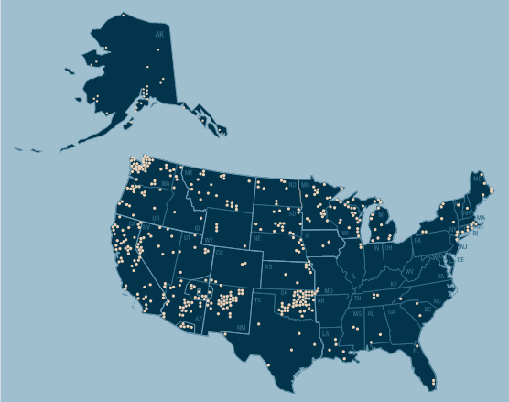
Special Diabetes Program for Indians 404 Grantees
Notes:
Here is a map of the SDPI Grant Program showing the 404 IHS, Tribal, and Urban Indian health SDPI programs in 35 states.

Slide 9

SDPI Community–Directed Programs
338 community-directed diabetes programs:
Implement diabetes treatment and prevention programs based on scientifically proven Best Practices
Are designed to address local community priorities
Have increased access to many types of services
Large variety of diabetes treatment and
prevention programs
- Makes for challenges in quantifying direct
impact of SDPI

Slide 10
SDPI Demonstration Projects: 2004-2008
Translated the results of diabetes prevention and cardiovascular disease risk reduction research into diverse, real world Indian health settings.
36 Diabetes Prevention projects achieved virtually the same results as NIH-led Diabetes Prevention Program (DPP) study.
30 Healthy Heart Projects successfully reduced CVD risk in people with diabetes.
Notes:
In 2004, Congress established the SDPI Demonstration Projects to translate research findings on diabetes prevention and cardiovascular disease risk reduction into AI/AN communities.
Overall, 66 grants were funded that served 110 tribal communities from 2004 to 2010. The Demonstration Projects have successfully completed a 6-year program translating the results of diabetes prevention and cardiovascular disease risk reduction research into diverse, real world Indian health settings.
36 Diabetes Prevention projects successfully achieved the same level of weight loss as an original NIH-funded Diabetes Prevention Program Research study. In doing so, they prevented onset of diabetes in high-risk American Indian and Alaska Native people at a rate similar to the NIH study.
And 30 Healthy Heart Demonstration Projects have successfully reduced cardiovascular disease risk in American Indians and Alaska Native people with diabetes. The percent of participants who met target goals for CVD risk factors (e.g., blood pressure and blood lipids) increased significantly after the case management intervention.
As a result of their work, we now know that it is possible to reduce risk factors for diabetes and cardiovascular disease in American Indian and Alaska Native communities.

Slide 11
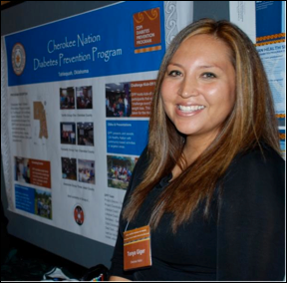
Demonstration Projects Transitioned to Initiatives: 2010 to Present
Current Initiatives:
38 Diabetes Prevention Initiatives
30 Healthy Heart Initiatives
Continuing their diabetes and cardiovascular risk reduction activities
Developing toolkits and will disseminate the lessons learned throughout AI/AN communities.
Notes:
In September 2010, as a result of a new competitive grant process, the IHS awarded 68 cooperative agreements to previous and new sites to continue implementing successful activities from the original Demonstration Projects.
There are 38 Diabetes Prevention Initiative sites and 30 Healthy Heart Initiative sites.
The Demonstration projects have been successfully transitioned to Initiatives Programs to continue documenting activities and outcomes and disseminating information and best practices from the original Demonstration Projects.

Slide 12
SDPI Administrative Support
National and Area Diabetes Consultants
Diabetes Data Infrastructure including EHR
Clinical Tools (e.g. algorithms, Standards of Care)
Diabetes Care and Outcomes Audit
Comprehensive Diabetes Training
Indian Health Diabetes Website: www.diabetes.ihs.gov
Notes:
The Indian Health Service Division of Diabetes Treatment and Prevention plays a central role in managing and supporting the Special Diabetes Program for Indians – a $150 million per year grant program. We strive to improve accountability and excellence in our programs through our national and area diabetes consultants by:
Translating and disseminating the latest science to Indian health programs
Providing comprehensive training on the latest diabetes science, best practices, and SDPI program management to the 404 SDPI grant programs.
Major accomplishments include developing clinical tools such as the Standards of Care, and systems that monitor the outcomes of diabetes clinical care, such as the Annual IHS Diabetes Care and Outcomes Audit, and creating diabetes surveillance systems for tracking diabetes prevalence and complications and a dynamic website.

Slide 13
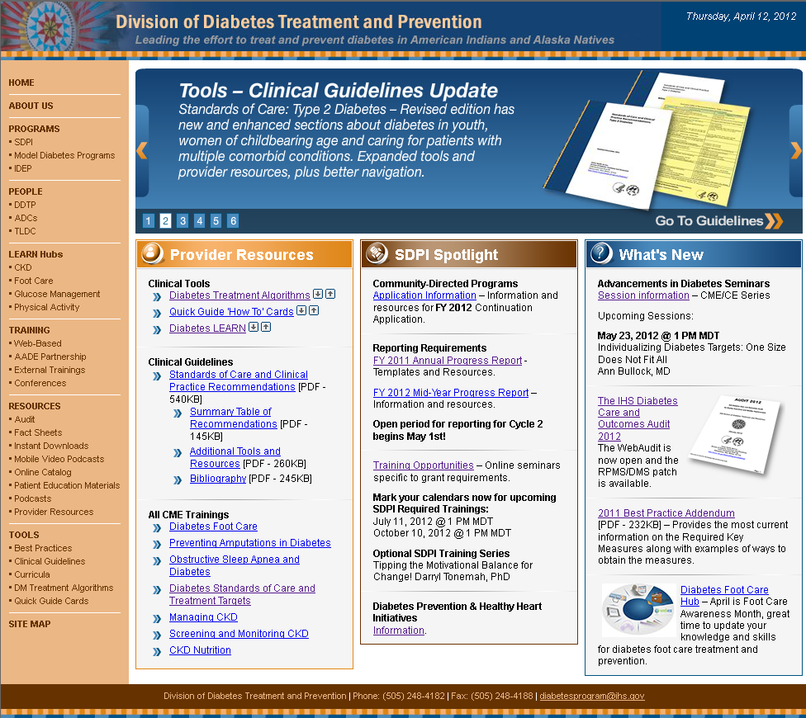
www.diabetes.ihs.gov – Home Page
Notes:
This is a screenshot of the IHS Division of Diabetes website’s homepage.
It is the “go to” source for clinicians, SDPI program managers and staff, and community members wanting to learn more about diabetes. There are provider resources, spotlight features of SDPI programs and ever changing “What’s New” resources,

Slide 14

SDPI Funds: Helping Make Real Success Happen
Funds People & ↑ Services
Programs
Improve Clinical Reduce Diabetes &
Measures Complications

Slide 15
SDPI: Increased Access to Diabetes Treatment and Prevention Services
 | 1997 - Before SDPI funding | 2010
Diabetes clinics | 31% | 71%
Diabetes clinical teams | 30% | 94%
Diabetes patient registries | 34% | 94%
Nutrition services for adults | 39% | 89%
Access to registered dietitians | 37% | 77%
Culturally tailored diabetes education programs | 36% | 99%
Access to physical activity specialists | 8% | 74%
Adult weight management programs | 19% | 76%
Source: Evaluation of the SDPI Community-Directed Diabetes Programs
Notes:
Now in its 14th year, the SDPI grant programs has implemented proven interventions to address the diabetes epidemic, often where few resources existed before.
Here are some examples of how SDPI has increased access for diabetes services:
An increase in diabetes clinics from 31% in 1997 before SDPI funding, to 71% in 2010.
Similar increases for diabetes clinical teams and registries.
And increased access to experts in nutrition, physical activity, and diabetes self-management education.

Slide 16
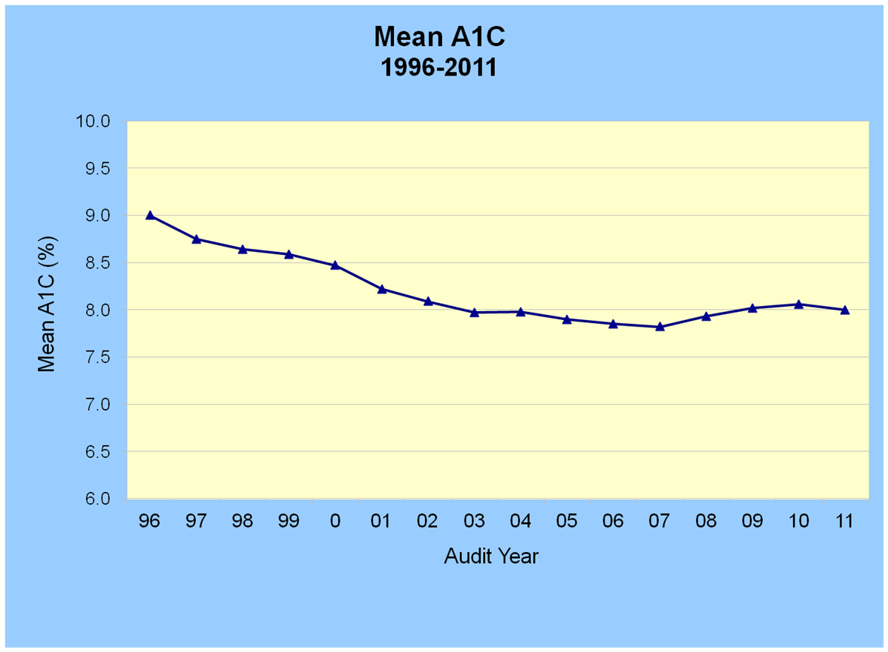
Average Blood Sugar
Source: IHS Diabetes Care and Outcomes Audit
Notes:
As access to diabetes services increased through the Special Diabetes Program for Indians, diabetes health outcomes improved significantly in American Indian and Alaska Native communities. One of the most important improvements has been a 13.7% decrease in the mean blood sugar level of American Indians and Alaska Natives with diagnosed diabetes, a major achievement over 15 years.
The average blood sugar level decreased from 9% in 1996 to 8% in 2011 as measured by the A1C test.
Decreases of this magnitude can reduce the risk of microvascular complications such as eye, kidney, and nerve diseases, by 40%*.
(* CDC. National diabetes fact sheet: national estimates and general information on diabetes and prediabetes in the United States, 2011. )

Slide 17
Average LDL Cholesterol
Source: IHS Diabetes Care and Outcomes Audit
Notes:
The average LDL cholesterol declined from 118 mg/dL in 1998 to 95 mg/dL in 2011 – below the Standards of Care Target for LDL cholesterol of less than 100 mg/dL.
Improved control of LDL cholesterol can reduce cardiovascular complications by 20-50%. (CDC. National diabetes fact sheet: national estimates and general information on diabetes and prediabetes in the United States, 2011. )

Slide 18
Average Blood Pressure
Source: IHS Diabetes Care and Outcomes Audit
Notes:
Blood pressure has been well-controlled throughout the SDPI era. The average blood glucose in 2011 was 131/75 mmHg.
Blood pressure control reduces the risk of cardiovascular disease among people with diabetes by 33-50% and reduces the risk of eye, kidney, and nerve complications by about 33%.
Lowering blood pressure in patients with early diabetic kidney disease can reduce the decline in their kidney function by 30-70%.
(CDC. National diabetes fact sheet: national estimates and general information on diabetes and prediabetes in the United States, 2011).

Slide 19
Use of ACE Inhibitors and ARBs for Blood Pressure Control
Source: IHS Diabetes Care and Outcomes Audit
Notes:
Use of blood pressure-lowering medications increased from 42% in 1997 to 72% in 2011.
Treatment with angiotensin-converting enzyme (ACE) inhibitors and angiotensin II receptor blockers (ARBs) has shown to be more effective in reducing the decline in kidney function than has treatment with other blood pressure-lowering medications (American Diabetes Association, 2012).

Slide 20
Adjusted Incident Rates of ESRD Due to Diabetes, By Race and Ethnicity
Source: United States Renal Data System, 2008
Notes:
The most important impact of these combined and sustained clinical improvements is seen in the dramatic drop in the rate of end stage renal disease, or ESRD, in American Indian and Alaska Native people with diabetes when compared with other racial and ethnic groups in the U.S.
Between 1995 and 2006, the incident rate of ESRD in American Indian and Alaska Native people with diabetes fell by 27.7% – a greater decline than for any other racial or ethnic group.
Given that Medicare costs per year for one patient on hemodialysis were $82,285 in 2009, this reduction in new cases of ESRD means a decrease in the number of patients requiring dialysis—translating into millions of dollars in cost savings for Medicare, IHS, and other third-party payers.

Slide 21
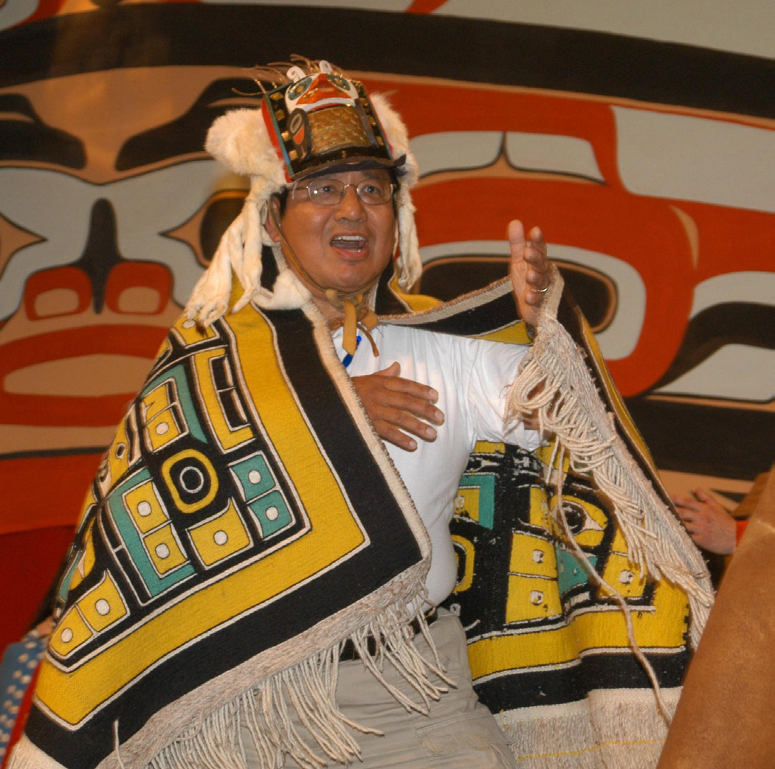
SDPI – 13+ Years of Successful Interventions and Sustained Achievements in Diabetes Outcomes
Why does SDPI work? Some thoughts…
Shines a sustained spotlight on diabetes
Diffusion
Accountability
Best Practices
Taps into the tremendous spirit of creativity and passion for the wellbeing of our people in our communities

Slide 22
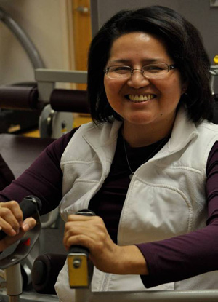
“I joined the Cherokee Diabetes Program in 2007 because my blood sugars were out of control, even though I was on the maximum dosage of insulin and oral medications.
“With the support of the program staff, I have lost 35 pounds and am in control of my diabetes.
“After 17 years, I no longer require insulin to manage my diabetes.”
Ulela Harris,
Eastern Band of
Cherokee Indians
Notes:
“I lost my parents and a sister from complications of diabetes.
I have 8 brothers and sisters living with diabetes. I was diagnosed in 1993.
My motivation to join the Cherokee SDPI Community-Directed Diabetes Program in 2007 came when I was at the clinic because my blood sugars were out of control, even though I was on the maximum dosage of insulin and oral medications. With the support of the program staff, I have lost 35 pounds and am in control of my diabetes. After 17 years, I no longer require insulin to manage my diabetes.
Honestly, I love the Cherokee Diabetes Program! It has challenged me in new ways and given me the opportunity to take control of my diabetes, my health, and my future.” Ulela Harris, Eastern Band of Cherokee Indians, NC

Slide 23
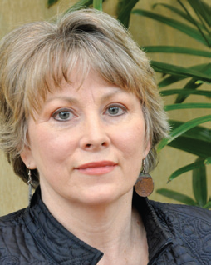
“Before SDPI, we had over a 5-month wait to get a patient into the diabetes clinic. SDPI funds have made possible a state-of-the-art diabetes program here in Cherokee where we see success stories every day of people controlling their diabetes. Without SDPI, we would go back to having too little care available for far too many patients.”
Sally Sneed Penick, RN, CDE
Eastern Band of Cherokee Indians, NC

Slide 24
SDPI Looking Ahead: The job is far from done
It will take decades of intense intervention to address diabetes
Scientific understanding of risk factors expanding well beyond genes and lifestyle choices
Many are related to the deepest issues in our communities
Poverty, food insecurity, trauma, depression, toxic exposures, etc.
We must have an infrastructure in place which can adapt
Diabetes is intricately connected to the healing of our communities

Slide 25
Indian Health Service Division of Diabetes Treatment and Prevention (DDTP)
Thank you
for your support of SDPI

Slide 26
The Chickasaw Nation Division of Health Diabetes Care Center
Shondra McCage, MPH
Diabetes Care Center Manager

Slide 27
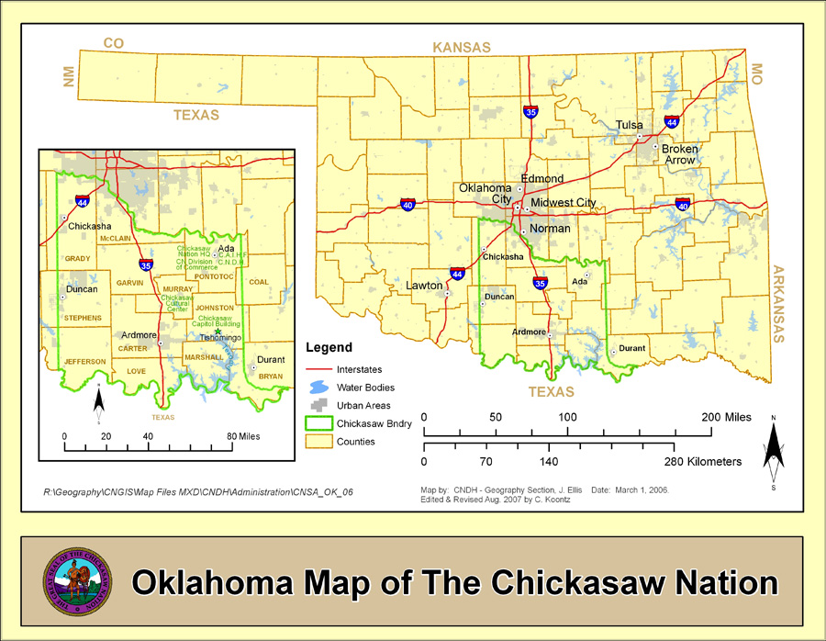
The Chickasaw Nation

Slide 28

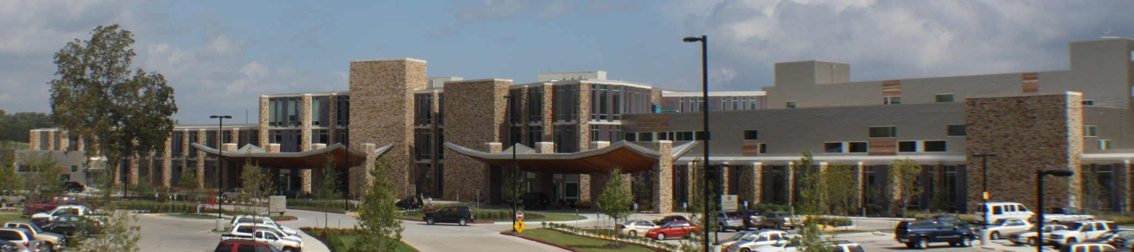
CNDH Chickasaw Nation Medical Center
User Population 31,863 (2010)
Inpatient Hospital
72 beds
ICU, OR, L&D
10 Outpatient Clinics & ED
4 Satellite Clinics
Ardmore, Tishomingo, Durant, and Purcell

Slide 29
CNDH Diabetes Care Center
Funded by
SDPI Community Directed Grant
SDPI Diabetes Prevention Initiative Grant
Certified DSME Program
IHS
AADE

Slide 30
CNDH Diabetes Care Center
Endocrinologist
Pediatric Endocrinologist(contract)
Medical Provider, PA-C
Nutrition Consults
Exercise Consults
Pharmacy Consults
Foot & Wound Care
Dental Hygiene
Retinography
Behavioral Health
Nephrology (contract)
Health Choice
Diabetes Education and annual exams/screenings
Gestational Diabetes Program
Education class for pregnant women with diabetes
Special Diabetes Prevention Program
Weight loss program for those at high risk
Kids’ Health & Fitness Clinic
Pediatric obesity & diabetes prevention classes
Diabetes Camp
Diabetes Camp Reunion
Staff & Services
Education Programs

Slide 31
CNDH Diabetes Care Center
IHS Diabetes Audit
Performance Improvement FY 2011 CNDH
Audit Item/Element | 2010 Audit Result | 2011 Audit Result
Depression Screening | 55 % | 72 %
A1c <7 | 11 % | 37 %
A1c <8 | 33 % | 51 %
Action | 1st Qt | 2nd QT | 3rd QT | 4th Qt
Foot Screening Threshold 86% | 50 % | 70 % | 90 % | 96 %
Smoking referral Threshold 12% | 0 % | 45 % | 81 % | 100 %

Slide 32
CNDH Diabetes Care Center
Diabetes Prevention Program Semi-Annual Progress Report Dec 2011
Outcome | Baseline (N= 116) | Follow-up (N= 96)
Weight (lbs) | 215.7 | 207.8
Body Mass Index (BMI) | 36.2 | 34.8
Waist (inches) | 43.9 | 42.5
Systolic BP (mm Hg) | 128.7 | 129.6
Diastolic BP (mm Hg) | 79.4 | 79.5
LDL (mg/dl) | 107.3 | 104.8
HDL (mg/dl) | 43.3 | 43.9
Triglycerides (mg/dl) | 136.6 | 120.2
Total Cholesterol (mg/dl) | 172.9 | 167.2
Glycemic Measure in Normal Range (%) | 17 | 48
% of participants reporting active physical activity | 25 | 57
Consumption of Healthy Foods Scale | 3.23 | 3.56
Consumption of Unhealthy Foods Scale | 3.03 | 2.46

Slide 33
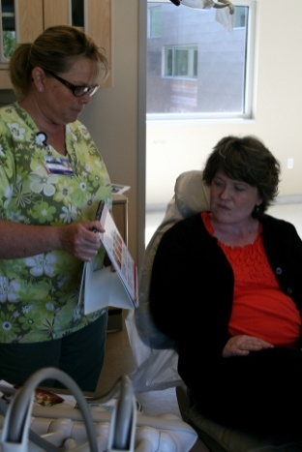
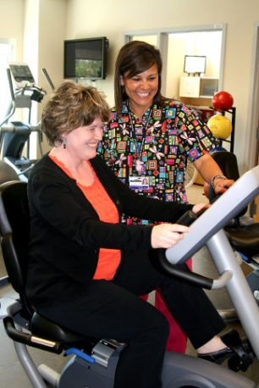
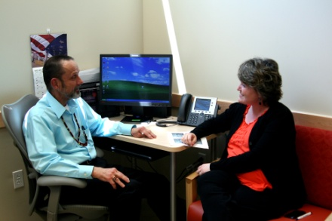
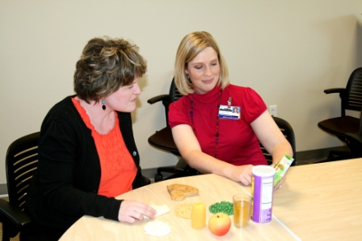
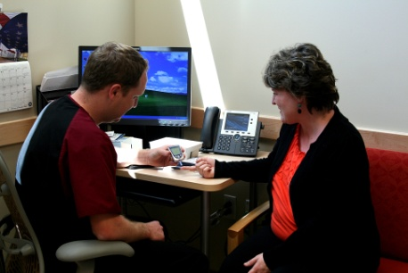
CNDH Diabetes Care Center
Program Highlights
GDM program
IHS Best Practice Program
Partner with The Gestational Diabetes Collaborative
Develop quality improvement strategies to improve diabetes data and patient care
Presented both oral and poster presentations at several conferences (CDC, AADE, IHS)

Slide 34
CNDH Diabetes Care Center
Impact on the Community
LOCAL
CN Employee Wellness Program
Potential to reach over 10,000 employees
Valley View Regional Hospital
Johnston County OSU Extension Office
Pontotoc Vo-Tech LPN program
East Central University Nursing Department
Public Schools Systems (Ada, Byng, & Latta)
Boys and Girls Clubs (Tishomingo & Sulphur)
Chickasaw Nation Headstart programs

Slide 35
CNDH Diabetes Care Center
STATE
Oklahoma Inter-Tribal Diabetes Coalition
OU Harold Hamm Diabetes Center
Oklahoma State Department of Health
Division of Chronic Disease
National
CDC / Division of Diabetes Translation and Reproductive health
National Association of Chronic Disease Directors
Women’s Health Council
American Diabetes Association

Slide 36
CNDH Diabetes Care Center
Research
OU Health Science Center
Oklahoma State University
Native American Research Center on Health
Masters Students
PhD. Students

Slide 37
CNDH Diabetes Care Center
Questions

Slide 38
Allen Dale (Navajo)
Oklahoma City, OK
My journey and connection to
the Special Diabetes Program for Indians

Slide 39
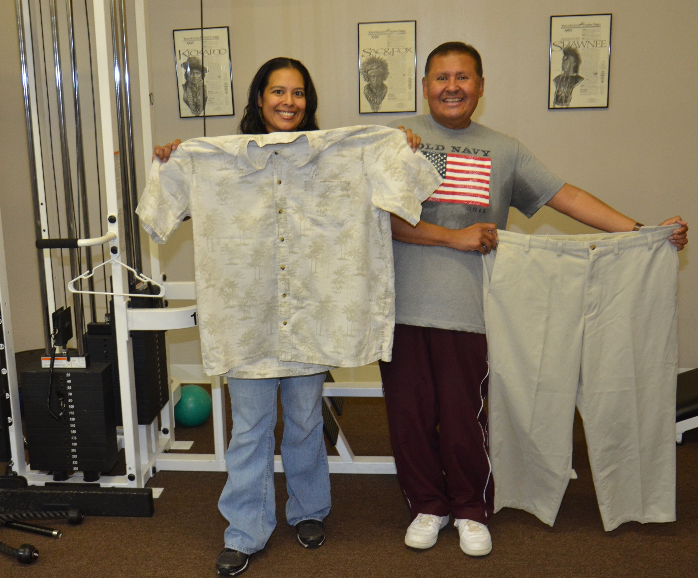
Allen before his participation in Get SET program

Slide 40
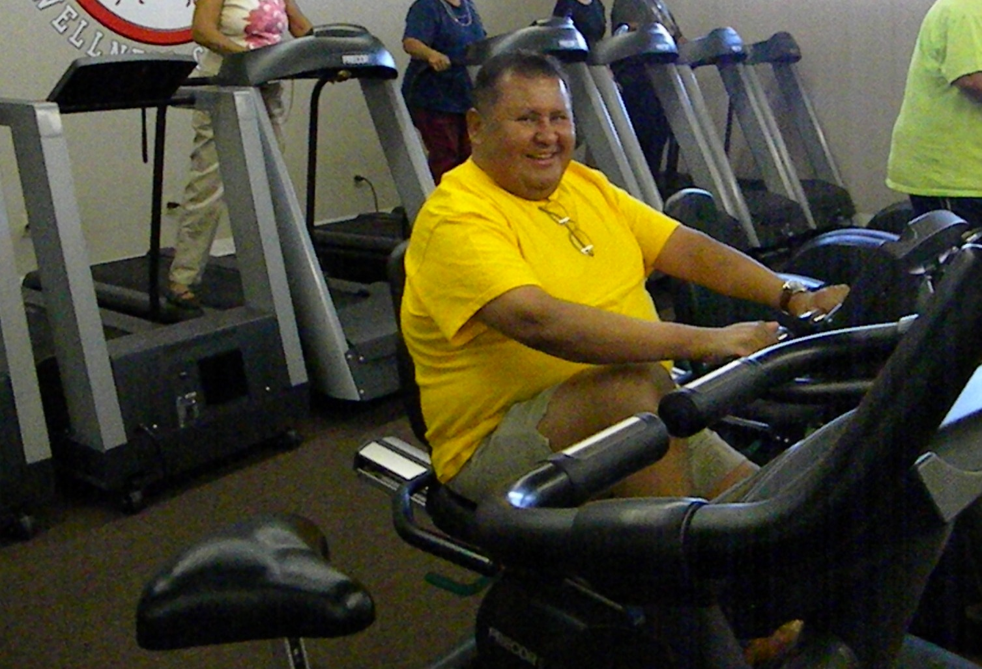
Allen at the start of his participation in Get SET

Slide 41
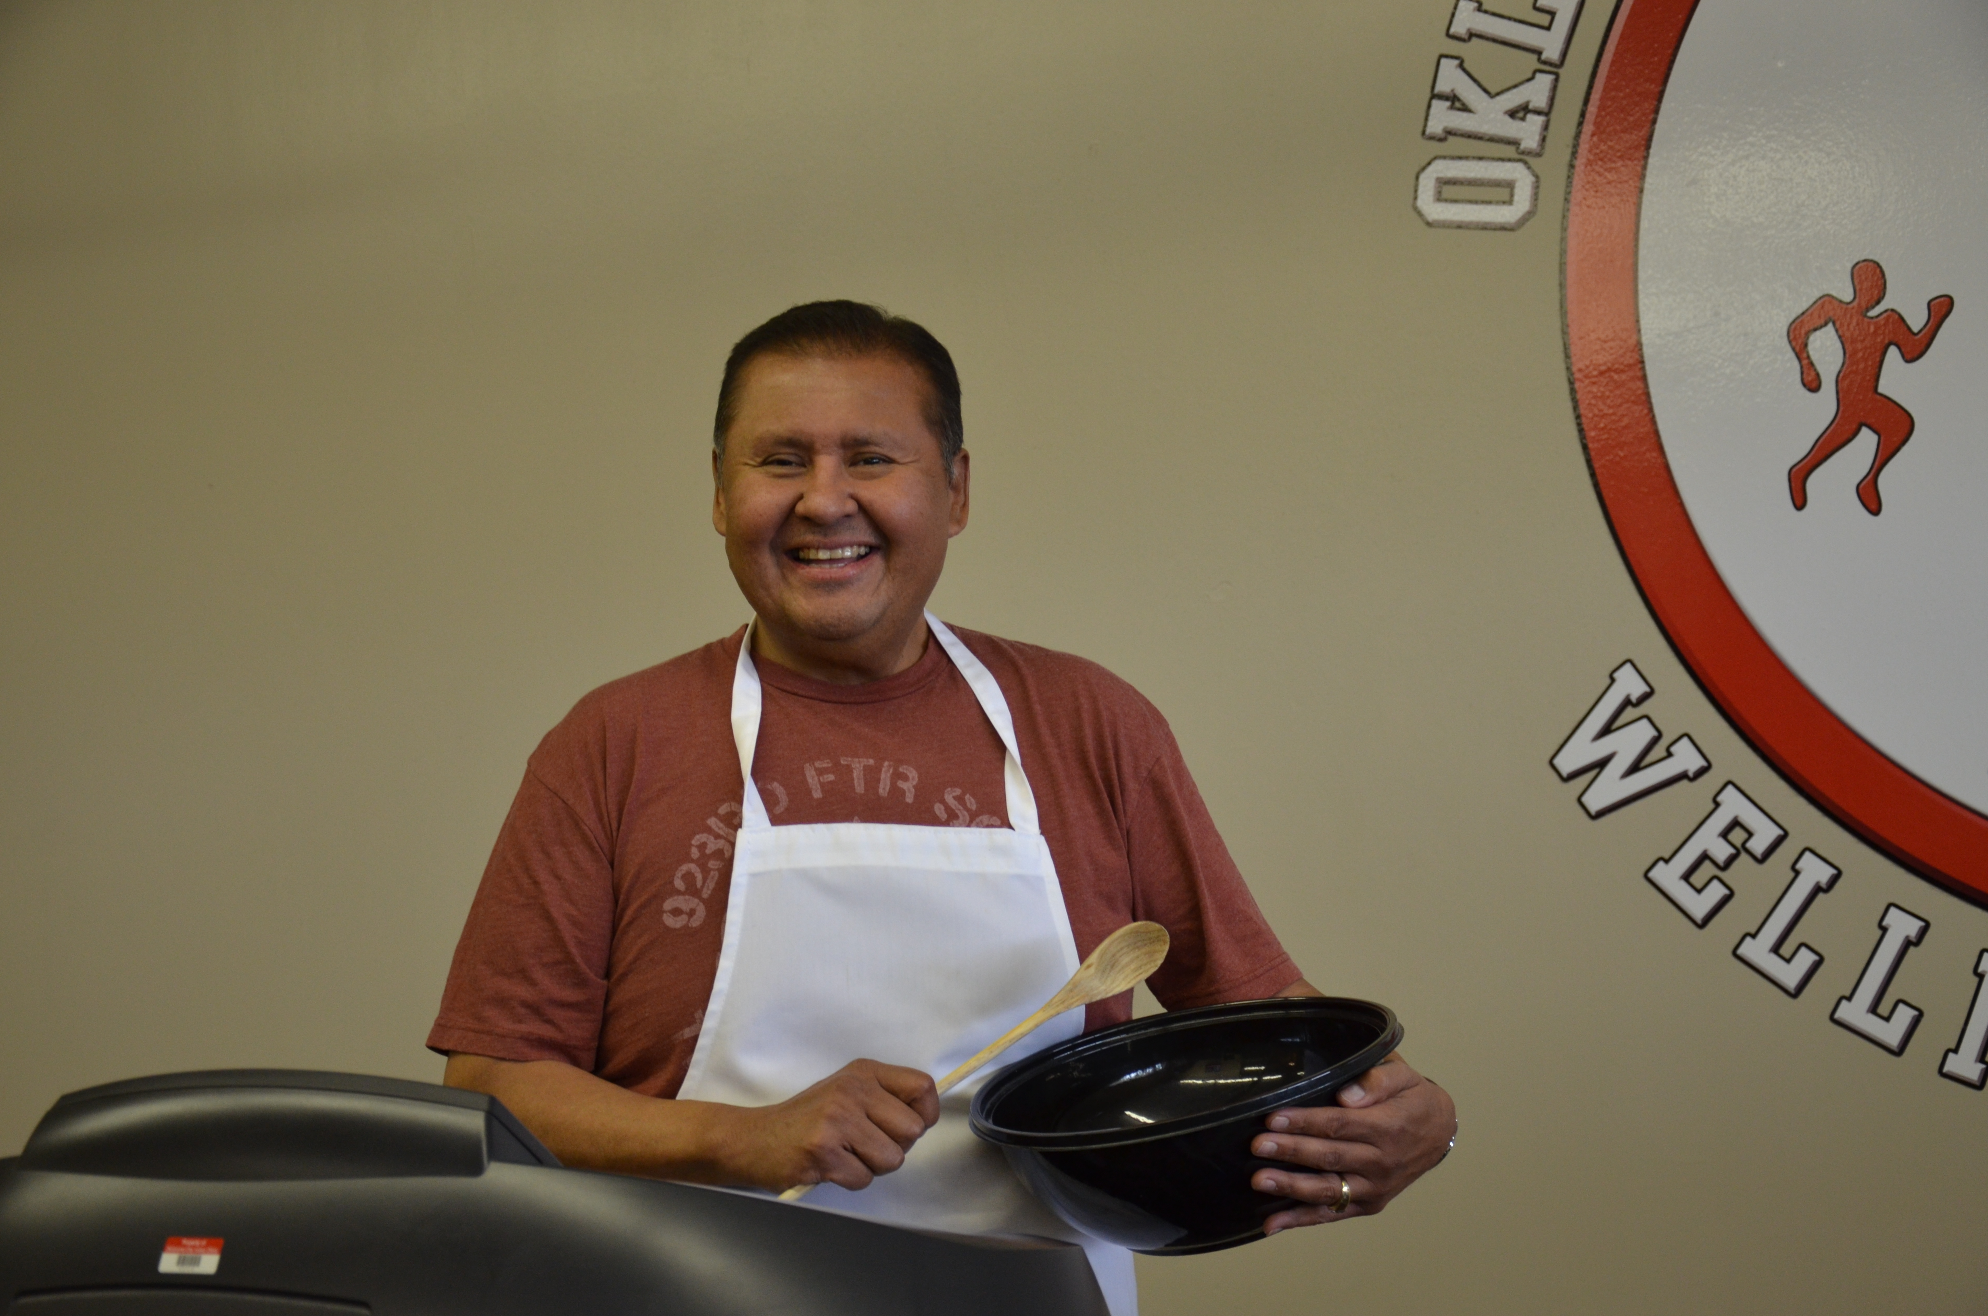
Looking good and feeling great!!

Slide 42

Jennifer Cooper
Legislative Director
National Indian Health Board
jcooper@nihb.org

